Slide 1

Microservice Architecture Used By Amazon AWS And Its Scalability And Reliability
Date: 2019-05-13
Group ID : <xxx-xxx-xxx>
Student ID | Name with initials
IT17016230 | Saranga S.A.G.
IT17006880 | De Silva N.
IT17012966 | L.S. Jayasinghe
IT17410250 | M.V Lakshitha
System : Amazon AWS
Architecture : Microservice Architecture
Key Qualities: Scalability and Reliability

Slide 2
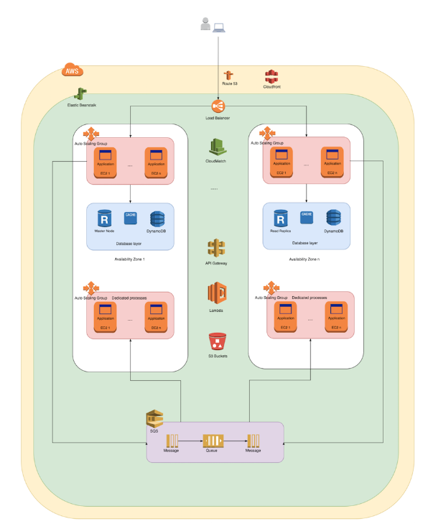
High level diagram of Amazon AWS service

Slide 3
Benefits of Scalability-what it offers
IT17006880
Allow each service to be independently scaled to meet demand
Can easily and accurately give teams the ability to accurately measure cost , maintainability, availability etc.
Optimal and appropriate technologies can be selected for a specific service
By optimizing as such can make use and leverage, and fine-tune each service for optimum performance.

Slide 4
Continued..
IT17006880
Decoupling microservices enable microservices to be scaled both vertically and horizontally independent from each other.
Microservice architecture enables the scaling process to be completely automated
Failing/failed components can be easily replaced facilitating resiliency

Slide 5
Some key points on how AWS makes use of scalability
IT17006880
Considering database scalability, AWS has the AWS RDS (Amazon Relational Database Service) and DynamoDB for NoSQL databases and with the help of caching by the Amazon Elastic cache, managed from the web console the data layer can be scaled vertically and horizontally when choosing aspects such as the amount of amount and type of storage space required etc.

Slide 6
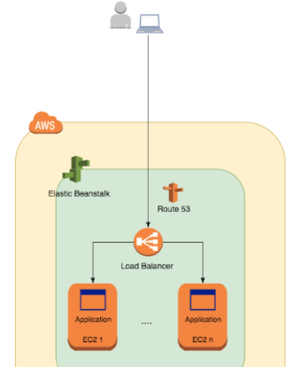
Continued..
IT17006880
Amazon EC2 instances(virtual machines used in the cloud connected via an SSH tunnel) are made fault tolerant by having exact replicas of the running code and having the ability to share and handle the same database layer and same set of information and a single point of access is maintained through an AWS load balancer.

Slide 7
Continued..
IT17006880
AWS load balancer responsible for :
- distributing through configured instances
-determining and send status only to the EC2 instances that appear healthy
Furthermore, the AWS Elastic Beanstalk is used to integrate, monitor, and orchestrate, the different components further reducing fault tolerance.

Slide 8
Continued..
IT17006880
Amazon AWS uses Auto Scaling service to determine and maintain and determine the minimum number of instances thereby reducing the number of idle server instances as well as costs.
Only when demand high, the number of server instances are increased and can support a large load of users and their data while maintaining key aspects such as performance.

Slide 9
Continued..
IT17006880
Amazon AWS also makes use of Availability Zones in which servers are located on several countries increasing the availability as well as replicate database components across the world.
Also, when scaling the performance is maintained through the Amazon Cloudfront service which acts as a middleware to redirect a user request to the location of the lowest possible latency.

Slide 10
What was before Microservices?
Back in 2001, Amazon’s application was one big monolith.
Netflix, eBay, Forward, Twitter, PayPal, Gilt, Bluemix, Soundcloud, The Guardian, and many other large-scale websites and applications have all evolved from monolithic to microservices architecture

Slide 11
What is a Monolithic application?
A monolithic application describes a single-tiered software application in which the user interface and data access code are combined into a single program from a single platform.
While its natural for new companies to take the monolithic-first approach because its quick and you can deploy quickly as well, over time, as the monolith gets bigger, breaking it down into microservices becomes the most convenient solution.

Slide 12
Why move to microservices?
With these applications become successful, Users like it and begin to depend on it.
So the traffic increases dramatically. And almost inevitably, users request improvements and additional features, so more developers are roped in to work on the growing application.
What happens when you have five independent development teams overlapping as they work on an application?
Code quality, application quality and availability suffers.

Slide 13
Continued..
Even the smallest change or bug fix requires a complete re-coding and re-deploying of a new version of the application.
With microservices, all the processes get simplified, scalable, and streamlined as all the functionalities are divided into independent units.

Slide 14
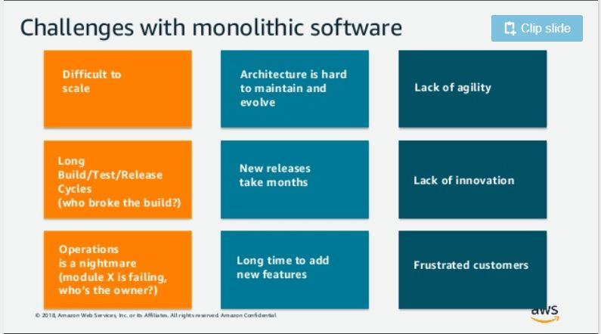
Continued..

Slide 15
Continued..
Amazon, Netflix and Apple, are all trailblazers in microservice architecture. These three companies dominate continuous delivery, DevOps, and show first-hand what microservice architecture can propel an organization into greatness.
when amazon was on a monolithic server, it was hard to predict how to meet the fluctuating traffic demands.
As a result, Amazon was bleeding money and most of the server capacity was wasted during downtimes.
Moving to the Amazon Web Services (AWS) cloud allowed Amazon to scale up or down when necessary, reduce the number and duration of outages, and save money.

Slide 16
Continued..
Microservice architecture allowed Amazon to transition to continuous deployment, and now Amazon engineers deploy code every 11.7 seconds

Slide 17
References
https://d1.awsstatic.com/whitepapers/microservices-on-aws.pdf
https://medium.com/@liamsolivera/scalability-in-amazon-web-services-4464e415b616
https://docs.aws.amazon.com/aws-technical-content/latest/microservices-on-aws/microservices-on-aws.pdf?icmpid=link_from_whitepapers_page
https://aws.amazon.com/microservices/
https://blog.leanix.net/en/why-netflix-amazon-and-apple-care-about-microservices
https://blog.newrelic.com/technology/microservices-what-they-are-why-to-use-them/
https://techsur.solutions/why-companies-like-netflix-uber-and-amazon-are-moving-towards-microservices/

